Slide 1

Welcome to
Driving Digital
Data Analyst & Operations Manager
Transformation for Business Growth
- Unlocking Market Growth & Operational Efficiency through Digital Innovation
Israel Josiah
Get Started
Candidate Presentation
29/1/2025

Slide 2

Executive Summary: Overview of the Digital Landscape
This analysis evaluates digital readiness, challenges, and opportunities across departments.
We identify key pain points, digital maturity levels, and critical areas for transformation.
Strategic recommendations focus on process automation, workforce enablement, data analytics, and cybersecurity.
Key Deliverables
✔ Sentiment Analysis on Digital Readiness ✔ Critical Response Evaluation ✔ Department-Wise Digital Maturity Score ✔ Process Optimization Insights ✔ Strategic Action Plan for Digital Growth
34%
Digital Readiness Score (Needs Improvement)
Get Started

Slide 3

Business Context & Need for Digital Transformation
Many defense organizations struggle with fragmented data systems, hindering real-time information sharing and comprehensive situational awareness
90%
Competitive Edge
Efficiency Gains
Businesses leveraging technology grow 2x faster
Automation and AI reduce operational costs by 30-40%
Technology Savvy (Required)
Transitioning to digital processes requires a cultural shift within organizations, which can be met with resistance from personnel accustomed to traditional methods.
Data-Driven Decisions
70% of businesses struggle with data management & analytics.

Slide 4
Current Digital Landscape at XYZ
AI-driven defense analytics.
Predictive Analysis.
Expected to grow at a CAGR of 13.3% from 2024-2030
Global digital transformation spending is projected to reach $3.4 trillion by 2026
📌 Challenges Identified:
1.
2.
🚨 Resistance to Change – Employees hesitant to adopt new technologies.
🚨 Siloed Data & Workflows – Lack of centralized data-sharing platforms.
🚨 Cybersecurity Risks – Low compliance with security protocols.
🚨 Legacy Systems – Slowing down operational efficiency.
13%
25%
34%
43%
56%
📌 Opportunities for Growth
✅ AI & Automation Implementation → Potential 40% reduction in costs.
✅ Cross-Functional Collaboration Tools → Boosts efficiency by 30%. ✅ Cybersecurity Investment → Reduces risk exposure by 60%. ✅ AI-Driven Predictive Analytics → Enhances real-time decision-making.
2027
2030
2035
2040
2045

Slide 5

Digital-Transformation
Why Digital Transformation?
"Digital transformation is not just about technology, it's about creating a culture of innovation."
– Thomas Siebel

Slide 6
Digital Maturity Levels
No Maturity
Conceptual
Defined
Integrated
Transformed
Digital change has been discussed in some areas, but there is still no implementation strategy.
Digital transformation has already been carried out with certain projects, but no cross-departmental corporate strategy can be defined.
Strategies are developed from pilot projects experiences. A basic awareness of digital change develops within the company.
Digital media is integrated more deeply into business models where strategies have been developed and implemented. Core processes products and series are digitized.
New approaches are emerging through the digitisation of core processes, products, and services. New control models are required. Corporate culture has undergone a lasting change.
Current state at XYZ with a 34 % DRI showing a moderate level of readiness with signs of resistance

Slide 7
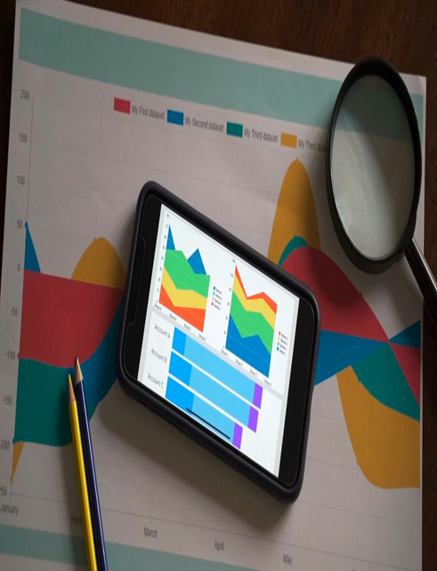
How We Conducted the Analysis
Key Targets
✅ Sentiment Analysis on Digital Readiness
✅ Critical Response Evaluation
✅ Department-Wise Digital Maturity Score
✅ Strategic Action Plan for Digital Growth
📌 Analysis Approach & Framework Used
Survey Data Cleaning & Data Standardization
Lean Six Sigma (Process Optimization)
Digital Transformation Pyramid Framework for XYZ
Data-Driven Decision Making (BI Tools & Visualization)
View Dashboard

Slide 8
Sentiment Analysis on Digital Readiness
Key Findings
📊 Overall Sentiment Score by Thematic Response
Negative Sentiment Areas:
High Readiness Areas (Positive Sentiment):
Challenges in Teamwork (-1)
AI/ML Integration (0.73)
Digital Skill Gaps (-1)
Digital Innovations (0.87)
Mitigating Security Threats (-1)
Data Analytics (0.53)
Need for Clarification (-1)
1.
2.
Key Takeaways
✔ Departments are eager to adopt AI/ML, Analytics & Innovation.
❌ However, skill gaps and cybersecurity risks pose major challenges.
View Dashboard

Slide 9
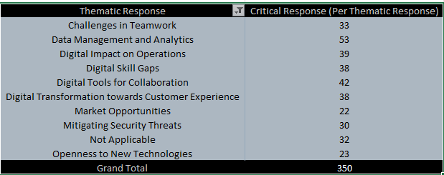
Top 10 Areas with Critical Issues
📊 (Stacked Column Chart: Critical Response Count Per Thematic Area)
Key Takeaways
✅ Digital tools for collaboration are a high-priority investment.
❌ Data challenges are restricting business agility.
📌 Market opportunities exist, but need the right strategy.
View Dashboard

Slide 10
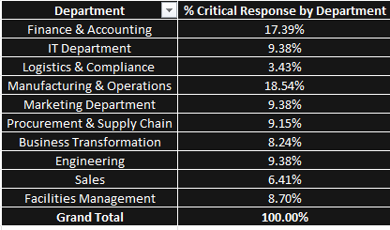
Critical Response Analysis Across Departments
📊 (Pie Chart: Critical Response Distribution by Department)
Key Takeaways
✔ Manufacturing & IT departments face the highest resistance to digital transformation.
❌ Logistics & Compliance show the least concern, possibly underestimating risks.
💡 Finance & Accounting have a medium digital adoption rate, needing structured integration.
View Dashboard

Slide 11
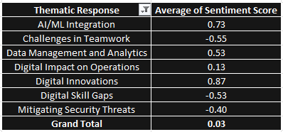
Readiness by Digital Category
📊 (Line Chart: Digital Readiness by Key Focus Areas)
Key Takeaways
✔ AI/ML and Digital Innovations lead in adoption readiness.
❌ Security threats, Teamwork, and skill gaps remain key concerns.
View Dashboard

Slide 12
Financial Impact & Business Intelligence Projections
📌 Projected Revenue Growth from
Digital Transformation:
📌 Cost Savings & Key Drivers:
📌 ROI of Digital Investments:
💰 Current Valuation: $100M (2024)
✔ AI-powered inventory & supply chain optimizes 60% of workflows → Saves $30M/year in labor costs.
✔ $50M investment in AI & data analytics → Expected 3x return in 5 years.
💰 Current Revenue: $350M (2024)
💰 Projected Revenue (2027): $500M (+43% growth with AI & automation)
✔ Expand global defense contracts → Secure long-term military & government procurement deals.
✔ $25M investment in cybersecurity → Prevents potential $100M data breach losses.
💰 Projected Revenue (2035): $1B (Fully integrated digital transformation)
Goal
💰Secure strategic investor partnerships to fund technology expansion.
75%
Growth within 10 years of digital transformation

Slide 13
Corporate Layers
Corporate Building Blocks
Corporate Goals
Achieve $1B Valuation in 10 Years through digital-driven operational efficiency and product innovation
Business
Model
Business
Strategy
Inside the company
Operations
Industry 4.0
Toward the market
Enhance Production Efficiency: Reduce operational costs and downtime through automation.
Manufacturing
Supply Chain
Logistics
Planning
Operating
Model
Go-to
Market
Corporate
Execution
Organization
Product
Process
Customer
Tools
Automate Repetitive Tasks to improve speed and accuracy. Enable Real-Time Monitoring across manufacturing and supply chain
ERP
Robotic Process Automation (RPA)
AI and Machine-learning
Smart Machines
Robots
Additive Manufacturing
AGV
IoT and Sensors
CRM
Chatbot
APIs
Big Data analytics
Collaboration channel (Slack, Microsoft Teams)
Enabling
Technologies
Digital Transformation Pyramid Framework for XYZ

Slide 14
Digital Transformation Process Step-by-step
Current State Assessment
Systemic Gaps
Future
Vision
People
Customer Centric Culture
Partner Enablement Programs
Personalized Buyer Engagement
Cross-Functional Collaboration
Superior Customer Experience
Process
Advanced Business Intelligence
Total Operational Integration
Digital Marketing Campaigns
Customer Lifecycle Analysis
Maximum Organizational Efficiency
Technology
Predictive Data
Analytics
Integration of AI Platforms
Integration of
Data Silos
Contextual Information Architecture
Integrated Information Infrastructure
Data Security
Digital Asset
Management
Product Information Management
Enterprise and Site Search Optimisation
Data Quality and Governance
Optimized Data Management

Slide 15
95%
75%
KPI & Measurement Framework
📌 Key Digital Transformation Metrics
55%
25%
-30%
✔ Sentiment Score Improvement Target: +25% increase in positive sentiment
✔ Skill Readiness: 55% of employees certified in AI/Data tools
✔ Critical Response Reduction: -30% in major pain points
✔ Teamwork: 75% utilization of communication & collaboration tools
✔ Cybersecurity Strength Index: 95% compliance with security protocols

Slide 16
Workforce Upskilling & Digital Readiness Plan
📌 Current Workforce Readiness:
📌 Upskilling Plan (2025-2028):
🟢 High adoption: Manufacturing & Operations (18.54%)
✅ Year 1: AI & Digital Literacy Training → 50% workforce trained
🟡 Moderate adoption: Engineering (9.28%)
✅ Year 2: ERP & Process Automation Training → 75% adoption rate
🔴 Low adoption: Logistics & Complains (3.43%)
✅ Year 3: Cybersecurity & Advanced BI Training → 90% digital proficiency
📌 Training Budget:
🎓 Investment Required: $20M over 3 years
🎓 Expected Gains: $150M in productivity improvement

Slide 17
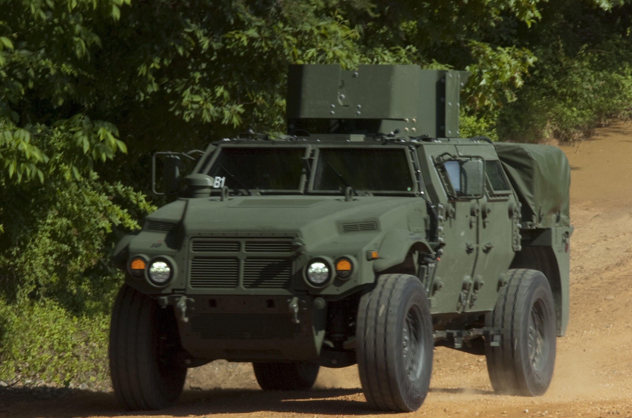
📌 Expected Business Impact by 2035:
1.
🚀 Revenue Growth: $1B valuation target achieved.
2.
🚀 Efficiency Gains: 40% reduction in operational costs.
3.
🚀 Market Leadership: Leading in AI-driven defense analytics.
With this roadmap, Tag Dynamics can ensure a seamless digital transformation, achieving efficiency, security, and innovation across all departments

Slide 18
Conclusion & Final Takeaways
📌 Key Findings
✔ Strong potential for AI, ML, and Innovation adoption.
❌ Skill Gaps, Teamwork & Cybersecurity Risks are critical challenges.
📈 Targeted training, process automation, collaboration, and stronger security can drive transformation success.
Step 1
✅ Approve $50M investment in AI, cybersecurity & automation.
Step 2
✅ Launch a company-wide digital training program.
Step 3
✅ Create cross-functional innovation teams to drive digital adoption.
✅ Conduct quarterly performance reviews on digital initiatives.
Step 4
20
30
40
50

Slide 19
Closing Statement & Call to Action
📌 Action Plan:
✔ AI & Automation drive efficiency & cost savings.
✔ Upskilling workforce and Teamwork is critical to transformation success.
✔ Cybersecurity remains a priority for risk mitigation.
✔ Digital transformation is essential for achieving $1B valuation.
📌 Final Thought:
“Digital transformation is not just about technology—it’s about building a culture of innovation that ensures sustained business growth.”

Slide 20
Digital Transformation
Thank You
For Attention
Israel Josiah. 28 Queen Elizabeth Street, GRA, Kaduna, Nigeria.
See you
29/1/2025

